Slide 1





Sao Paulo, Brazil October 2014
Quantitative modelling of electron transport using DFT
Ivan Rungger, Amaury de Melo Souza, and Stefano Sanvito
School of Physics and CRANN, Trinity College Dublin, IRELAND
Notes:
1

Slide 2



Trinity College Dublin
CRANN

Slide 3
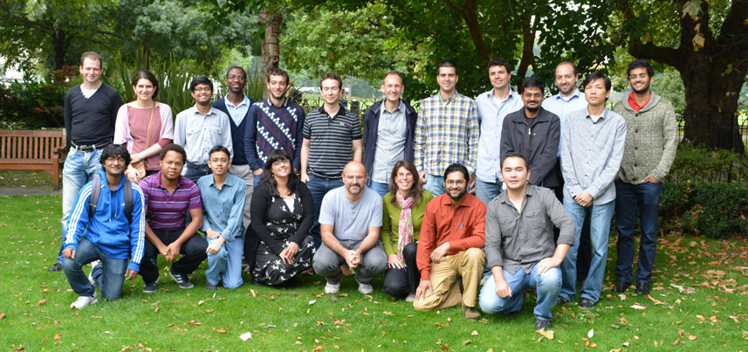
Computational spintronics group
Notes:
3
Say what I do

Slide 4
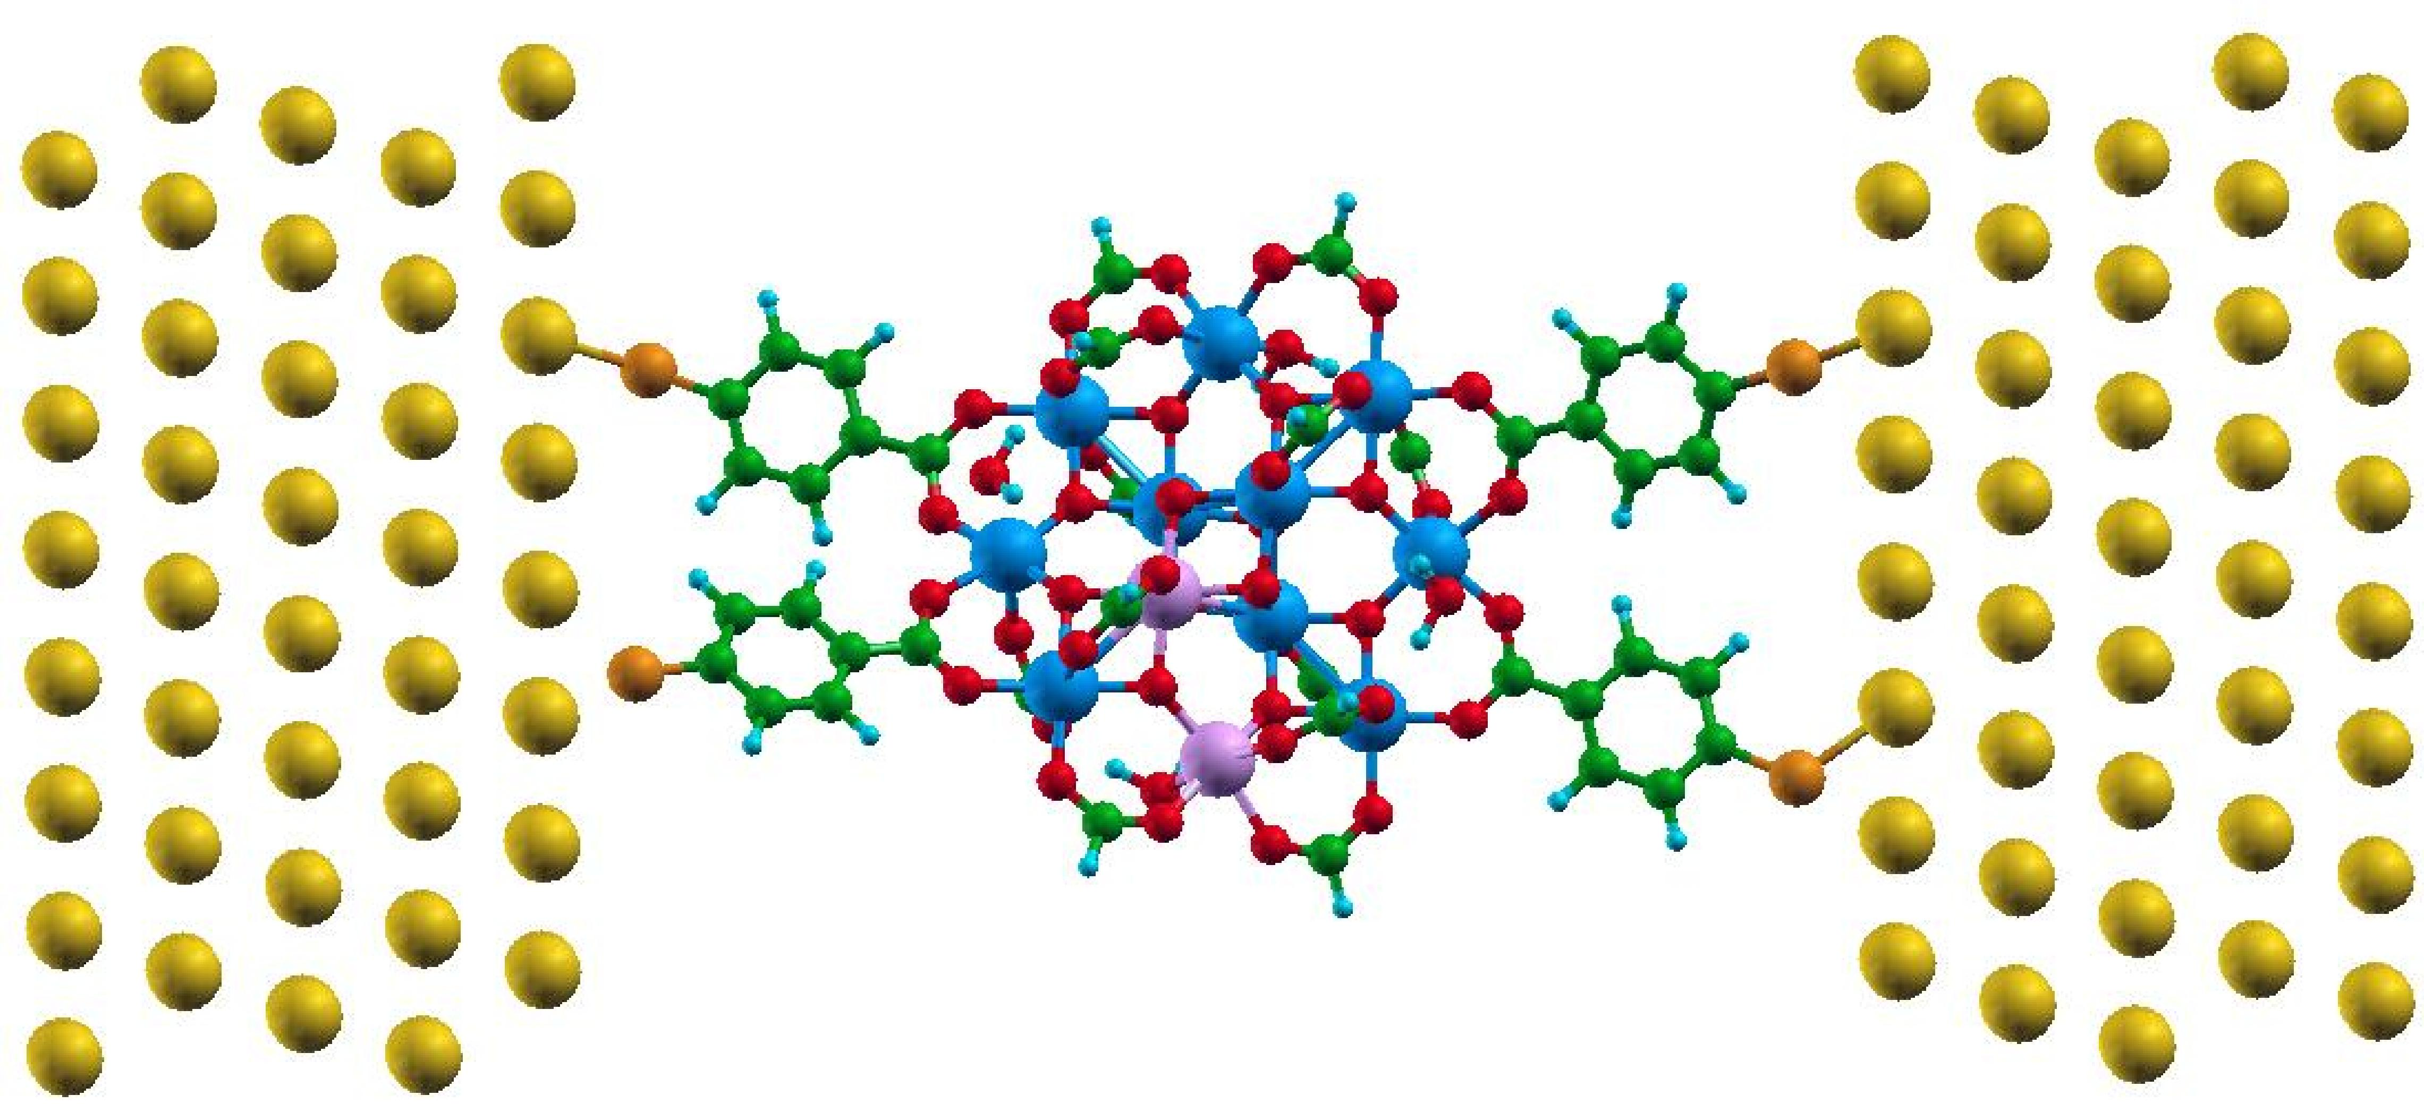
Quantum electron transport
I
We calculate the current I at a given voltage V using Hamiltonians obtained from DFT
Notes:
4

Slide 5
Outline
Lecture 1: Practical introduction to quantum transport
Why is it important?
From simple models to NEGF
Inelastic scattering within NEGF
Lecture 2: Is DFT-transport predictive?
DFT based electron transport
Problems with DFT for transport through molecules
Master equation approach
Lecture 3: Solid state spin-electronics devices
Magnetoresistance in magnetic tunnel junctions
Spin transfer torque
Strong correlations: Kondo effect
Notes:
5
Mention: “is it predictive”: once we know all atomic positions, can we predict the transport properties?

Slide 6
Literature
S. Datta, “Electronic Transport in Mesoscopic Systems” (Cambridge University Press, Cambridge, UK, 1995).
S. Sanvito, “Ab-initio methods for spin-transport at the nanoscale level”, in "Handbook of Computational Nanotechnology" (American Scientific, Stevenson Ranch, CA, 2005), Vol. 5; also available at
cond-mat/0503445.
M. Di Ventra, "Electrical Transport in Nanoscale Systems" (Cambridge University Press, Cambridge, UK, 2008).
E. Economou, “Green’s Functions in Quantum Physics” (Spinger-Verlag, Berlin,1995).
Notes:
6

Slide 7
Why care about electron transport at the nanoscale?
Notes:
7

Slide 8
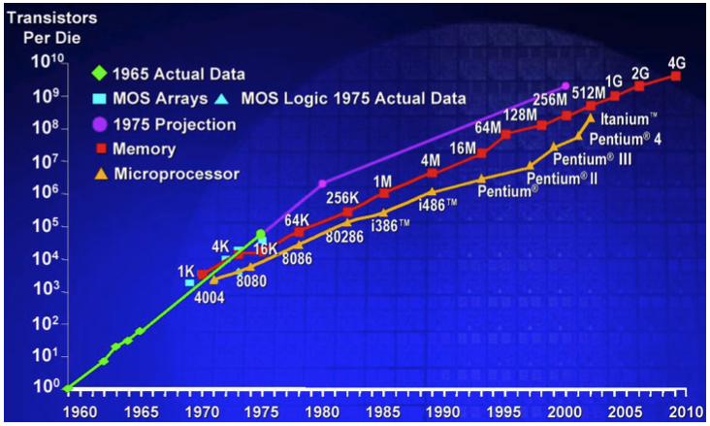
Why is it useful ?
Courtesy of Intel

Slide 9
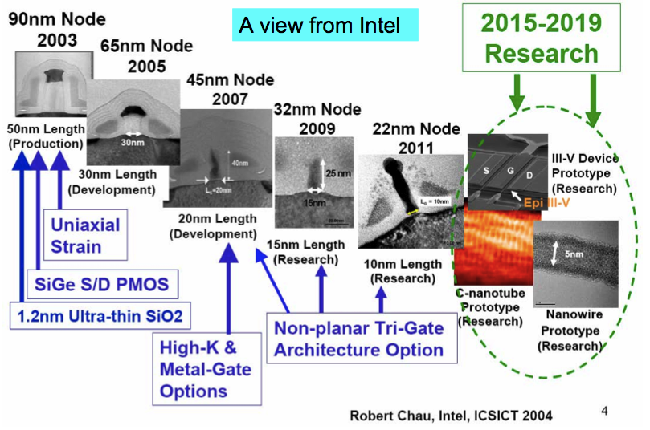
Why is it useful ?
Latest Intel nodes in production (Core M): 14 nm

Slide 10
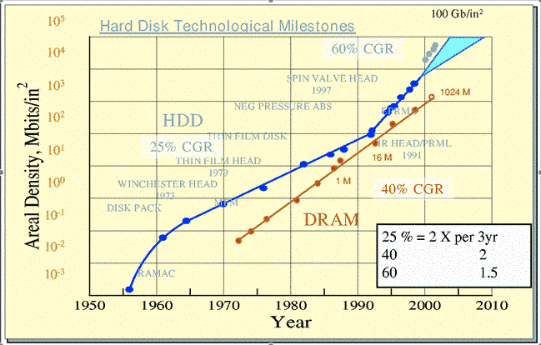
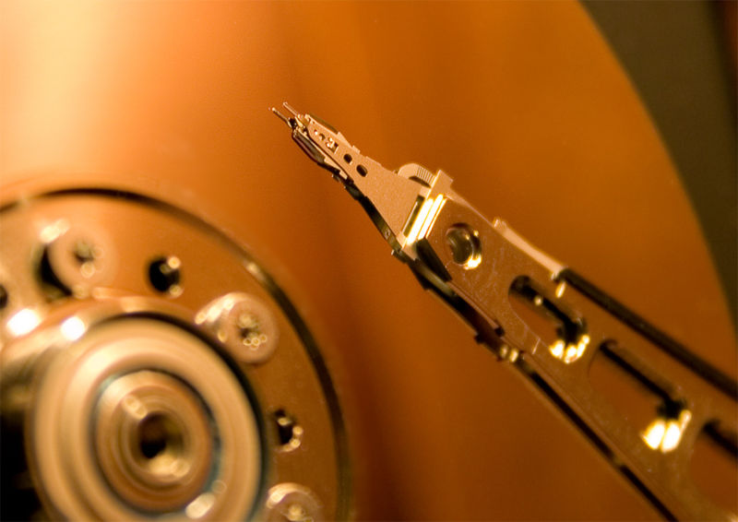
Why is it useful ?
Courtesy of Seagate
Hard-disk technology
Courtesy of IBM

Slide 11
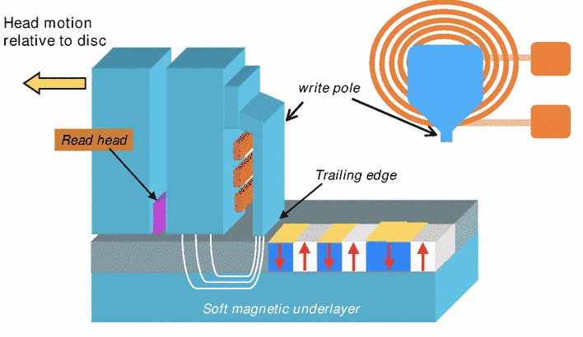
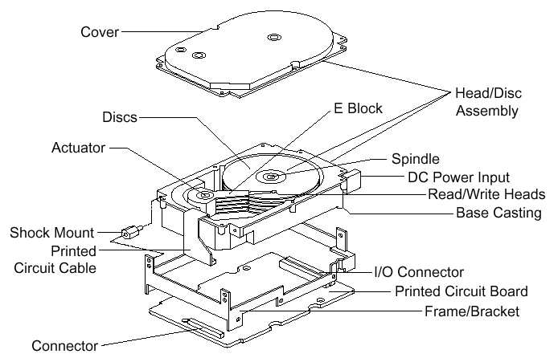

Slide 12
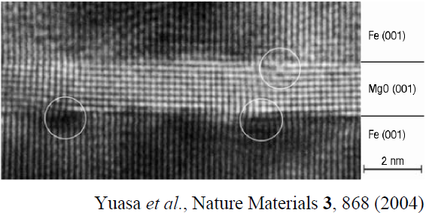
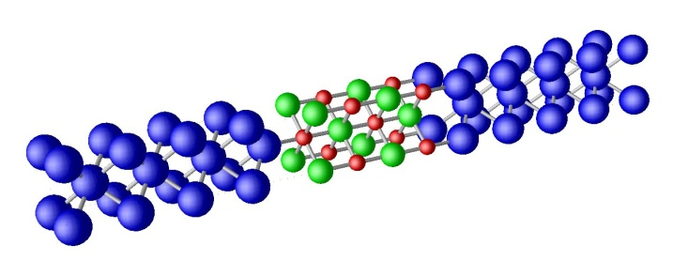
Tunneling magneto-resistance (TMR)
I
I
MR =
P
AP
S. S. P. Parkin et al., Nature Materials. 3, 862 (2004)
I
AP
Parallel
Theoretical prediction:
Anti-Parallel
W.H. Butler et al., PRB 63, 054416 (2001)
Notes:
Mention that part of difference between theory and exp is due to defects

Slide 13
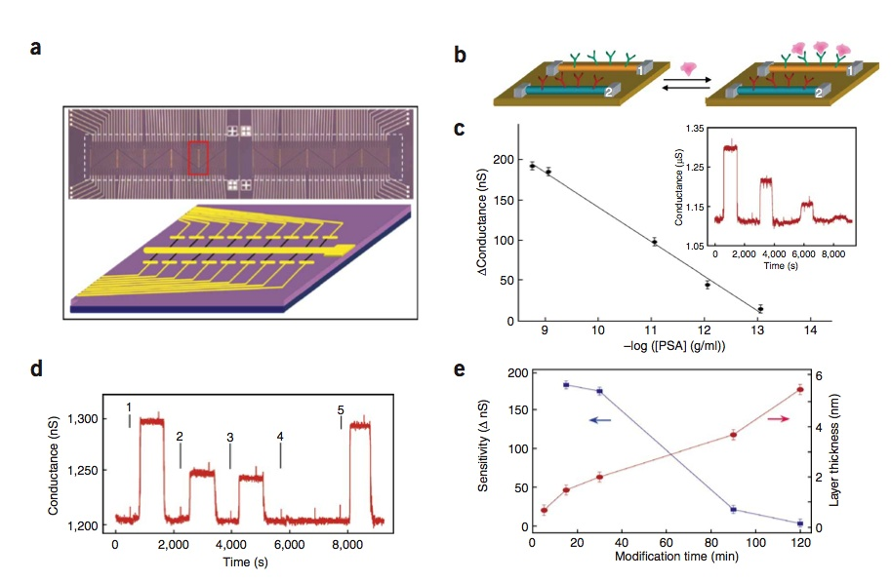
Why is it useful ?
Bio-sensors
G. Zheng et al. Nature Biotech. 23, 1294 (2005)
Notes:
Mention:
->na sequencing
->organic electronics mention

Slide 14
Explaining quantum transport
Notes:
14

Slide 15
How experiments are made ?
Nanogaps and break junctions
M. L. Perrin et al., Nature Nanotech. 8, 282 (2013)
Notes:
Explain measurements and problems

Slide 16
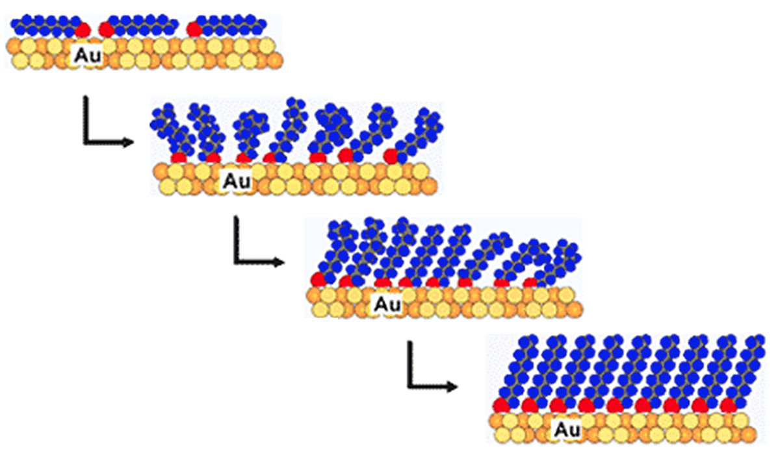
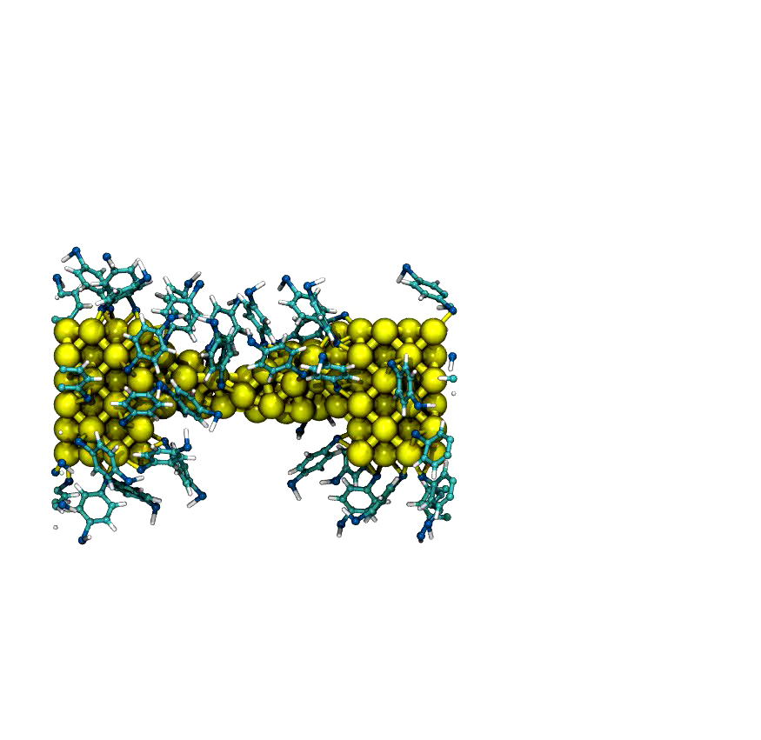
How experiments are made ?
STM tip
V
MCBJ (MD+MC)
J. Hihath et al., ACS Nano 5, 8331 (2011)
STM break junctions
W. French et al., Nanoscale 5, 3654 (2013)
Notes:
Explain measurements and problems

Slide 17
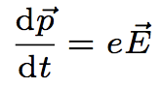
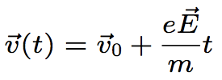
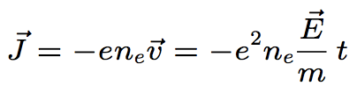
Classical Transport
Classical transport requires scattering
E
v
Current increases in time!!
Notes:
17

Slide 18
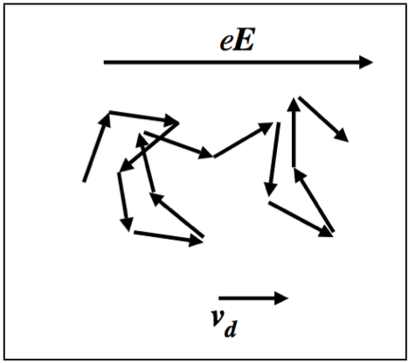
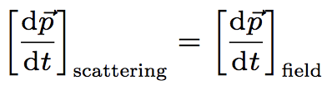
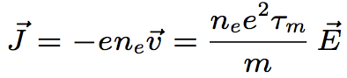
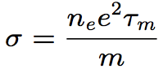
Ohm’s law
Nano-device
Notes:
18

Slide 19
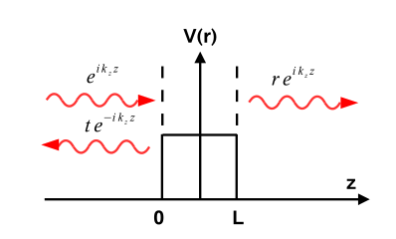
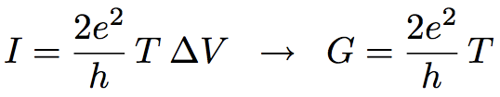
Quantum Transport: scattering theory
R=r²
T=t²
t
r
R. Landauer, Phil. Mag. 21, 172 (1970); M. Buttiker et al., PRB 31, 6207 (1985)
1)We need accurate potentials for real systems, and k(E): DFT
2)We need a tool to calculate T and R: NEGF
Notes:
19

Slide 20
Water flow versus electron flow
Notes:
20

Slide 21
Water flow vs. electron transport
Left Water
reservoir
Right Water
reservoir
How large is the water flow from the left to the right reservoir?
How high is the water in the middle container?
Notes:
21

Slide 22
μ_{L}
ε
μ_{R}
γ_{R}
γ_{L}
P_{L}=gμ_{L}ρ
P_{ε}=gερ
P_{R}=gμ_{R}ρ
Notes:
22

Slide 23
Equilibrium
μ_{L}
ε
γ_{L}
P_{L}= P_{ε}
Notes:
23

Slide 24
Equilibrium
ε
μ_{R}
γ_{R}
P_{ε}=P _{R}
Notes:
24

Slide 25
Non-equilibrium
μ_{L}
P_{ε}=gερ
ε
μ_{R}
γ_{R}
γ_{L}
I_{IN} = γ _{L}(P_{L}- P_{ε} )
I_{OUT} = γ_{R} (P_{ε} - P_{R})
I_{IN}=gργ_{L} (μ_{L}-ε)=Γ_{L} (μ_{L}-ε)
I_{OUT} =gργ_{R} (ε-μ_{R})=Γ_{R}(ε-μ_{R})
Steady state condition:
I_{IN} = I_{OUT}
Notes:
25
Hagen-Poiseuille equation: deltaP=8 mu L I/(pi r^4)
So that
I= ((pi * r^4)/(8 mu L)) *deltaP
gamma_L=((pi * r^4)/(8 mu L))

Slide 26
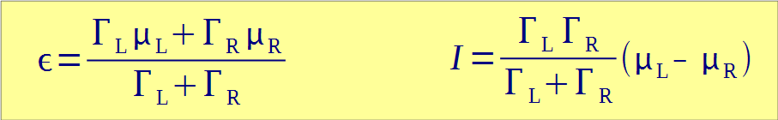
Non-equilibrium
μ_{L}
P_{ε}=gερ
ε
μ_{R}
γ_{R}
γ_{L}
Notes:
26

Slide 27
Equilibrium vs. non-equilibrium
Equilibrium: state is found by minimizing the free energy (variational principle)
Non-equilibrium: steady state is given by a rate-equation, the current is given by the different rates of in-and out-flow from the central container. There is no variational principle!
Notes:
27

Slide 28
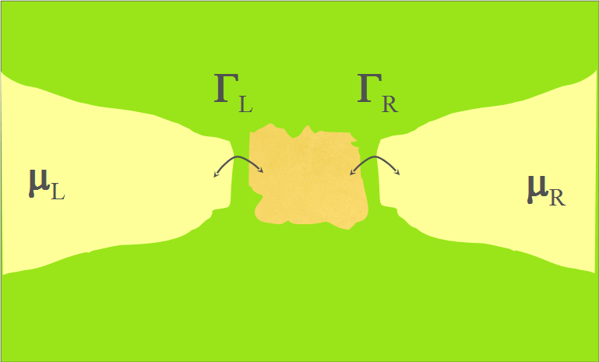
Let’s go back to electron transport…
Notes:
28
Mention: gamma is inversely proportional to the time it lifetime of an electron on the dot

Slide 29
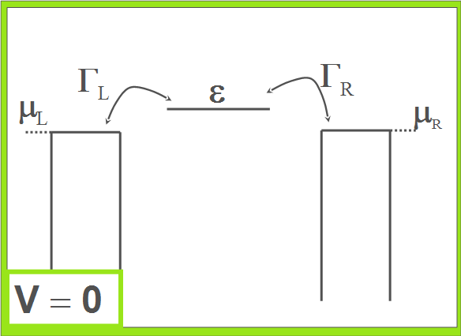
Single level transport
Notes:
29

Slide 30
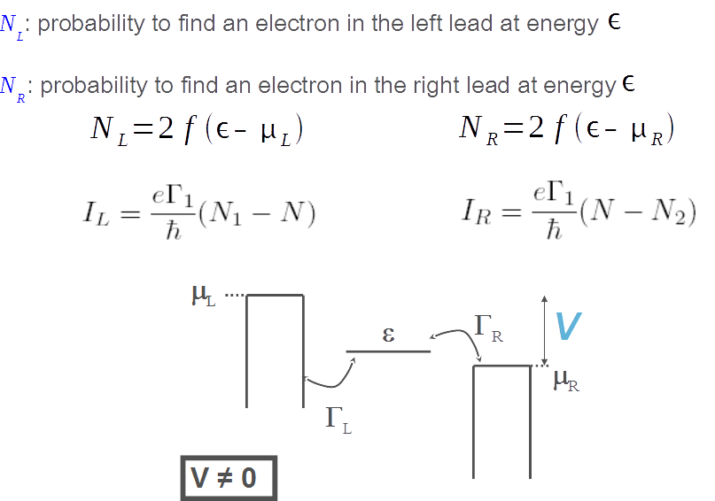
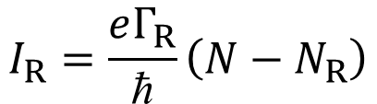
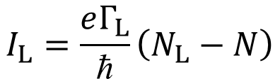
Water flow vs. electron transport
$$I_{L}=\frac{eΓ_{L}}{\text{ħ}}\left(N_{L}−N\right)$$
$$I_{R}=\frac{eΓ_{R}}{\text{ħ}}\left(N−N_{R}\right)$$
Steady state condition:
I_{L} = I_{R}
Notes:
30

Slide 31
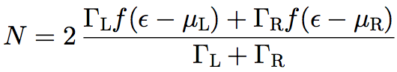
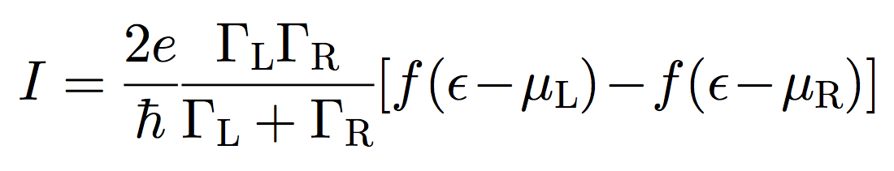
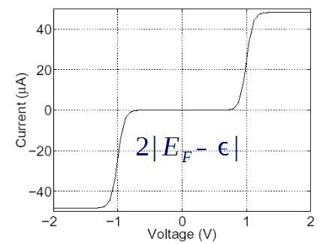
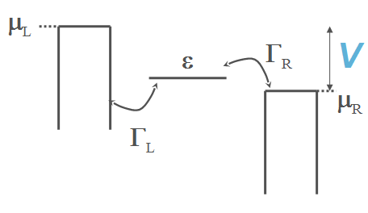
Occupation and current
V ≠ 0
Notes:
31

Slide 32
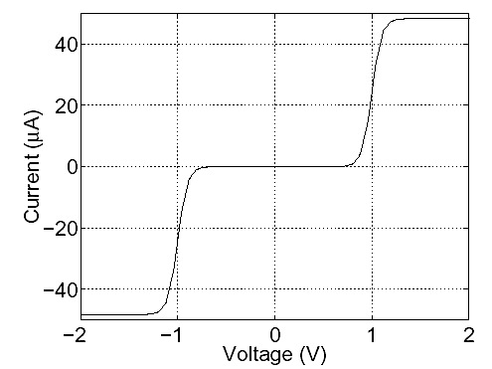
Occupation and current
Energy
μ_{L}
μ_{R}
EF
Γ
Γ
Au
Au
V≠0
V=0
Notes:
32

Slide 33
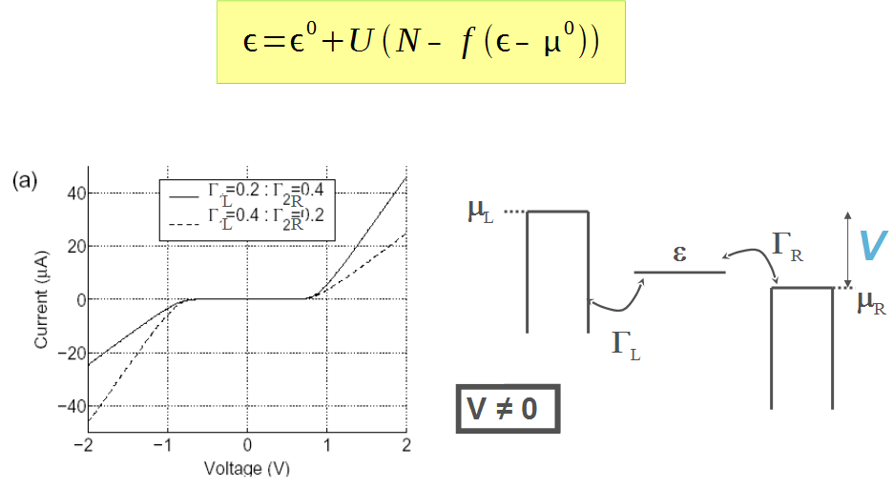
Charging leads to a shift of the energy level
Notes:
33

Slide 34
How is all this related to Green’s functions?
Notes:
34

Slide 35
From simple model to GF
Γ_{L}
ε
Γ_{R}
μ_{L}
μ_{R}
V = 0
Γ=Γ_{L}+Γ_{R}
δ(Ε − ε)

Slide 36
From simple model to GF
The formalism gets modified as following
2

Slide 37
From simple model to GF
The formalism gets modified as following

Slide 38
From simple model to GF
Now introduce the Green’s Function
Notes:
Mention: i(g-g*)=2Im(g) is the imaginary part

Slide 39
From simple model to GF
I and N can be expressed with the Green’s Function
2
Notes:
Factor for spin?

Slide 40
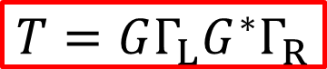
From simple model to GF
I and N can be expressed with the Green’s Function
Transmission coefficient:
$$T=GΓ_{L}G^{∗}Γ_{R}$$

Slide 41
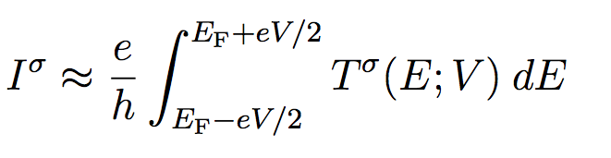
Interpreting the current again
E +eV/2
F
E -eV/2
F
E
Γ= Γ_{L}+ Γ_{R}
T(E)

Slide 42
Self-consistent calculation
The position of the energy level generally depends on the occupation
The calculation needs to be self-consistent

Slide 43
Self-consistent calculation
This is the NEGF method
2
Notes:
Use T here

Slide 44
From single level to atomistic
E +eV/2
F
γ_{α}^{L}
γ_{α}^{R}
E -eV/2
ε_{α}
F

Slide 45
From single level to atomistic
Notes:
Replace sigma by Im[sigma]

Slide 46
From single level to atomistic
NEGF
H_{L} [ρ_{L} ]
Σ_{L}
+
H_{M} [ρ]
+
H_{R} [ρ_{R} ]
Σ_{R}
I

Slide 47
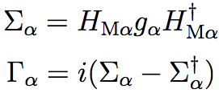
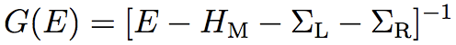
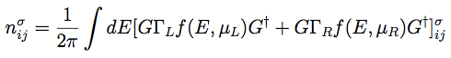
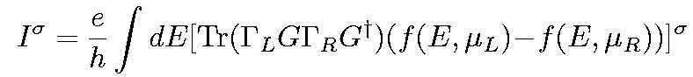
From single level to atomistic
A. R. Rocha and S. Sanvito, PRB 70, 094406 (2004)

Slide 48
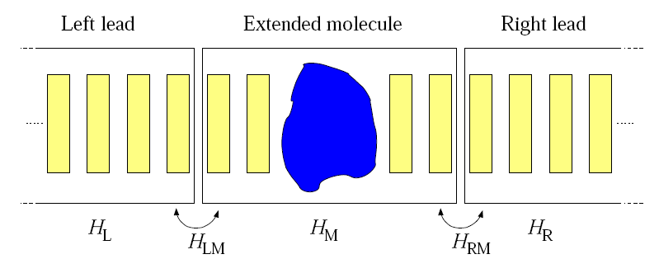
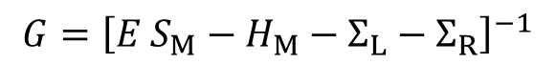
Smeagol: first principles electron transport
Density Functional Theory (DFT)
+
Non-equilibrium Green’s functions (NEGF)
I
$$G={\left[E S_{M}−H_{M}−Σ_{L}−Σ_{R}\right]}^{−1}$$
SMEAGOL (NEGF): A. R. Rocha et al., PRB 73, 085414 (2006); Nature Materials 4, 335 (2005);
I. Rungger et al., PRB 78, 035407 (2008); http://www.smeagol.tcd.ie
SIESTA (DFT): J. Soler et al., J. Phys.: Condens. Matter 14, 2745 (2002)
Notes:
48

Slide 49
Some DFT transport codes
AitransS
ATK (commercial)
DFTB
GPAW
Hirune
Smeagol
TranSiesta
TransSampa
WanT
…..
Notes:
49
Mention: all based on localized orbitals basis sets

Slide 50
Many degrees of freedom…
GATE
V
I

Slide 51
Elementary excitations

Slide 52
Transport and elementary excitations
hν

Slide 53

Transport and elementary excitations
Change energy, spin, phonon number ….
μ_{L}
μ_{R}
Γ_{L}
Γ_{R}

Slide 54
Transport and elementary excitations
NEGF
Σ_{L}(E)
+
H_{M} [ρ] + Σ_{in} [E,ρ, δ ]
H_{M} [ρ]
+
Σ_{R} (E)
I
Notes:
What is delta? The coupling?

Slide 55
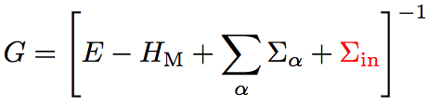
Transport and elementary excitations
_
_

Slide 56
Transport and elementary excitations
Y. Meir and N. S. Wingreen, PRL 68, 2512 (1992)
Notes:
Mention: total current is not just a transmission function: incoherent transport

Slide 57
Phonon scattering
Inelastic electron tunnelling spectroscopy (IETS)
General behavior:
T < 0.5 -> phonon excitation leads to increased conductance
T > 0.5 -> phonon excitation leads to decreased conductance
M. Paulsson et al., PRB 72, 201101(R) (2005)
J. K. Viljas et al., PRB 72, 245415 (2005)
T. Frederiksen et al., PRL 93, 256601 (2004)
J. Hihath et al., ACS Nano 5, 8331 (2011)
Notes:
Yyy: reduce text

